Slide 1
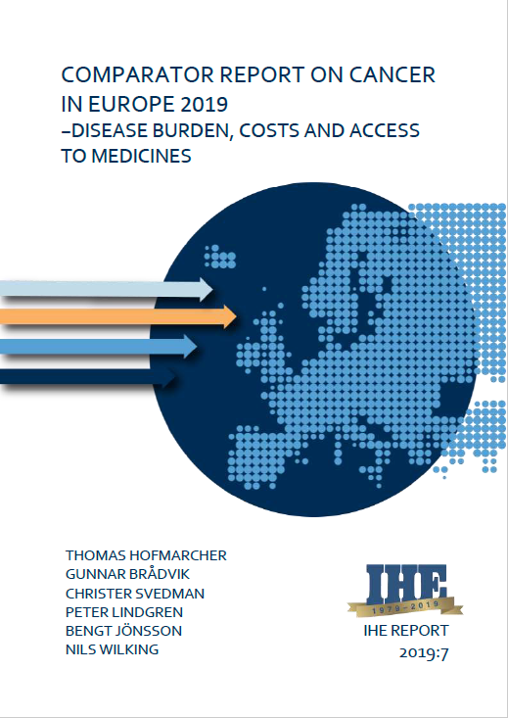
Disease Burden, Costs and Access to Valuable Cancer Medicines:
how the pandemic has influenced the disease burden
Bengt Jönsson
Professor emeritus, Stockholm School of Economics
Launch of the European Parliament Challenge Cancer Intergroup
Wednesday, 1 July 2020 – 16.30-19.00 CET (online event)
Notes:
My presentation is based on data from a recently published report from IHE, The Swedish Institute for Health Economics. This was published before the pandemic, but the results are still valid and conclusions reinforced by the impact of the pandemic, which I will touch on at the end of the presentation.

Slide 2
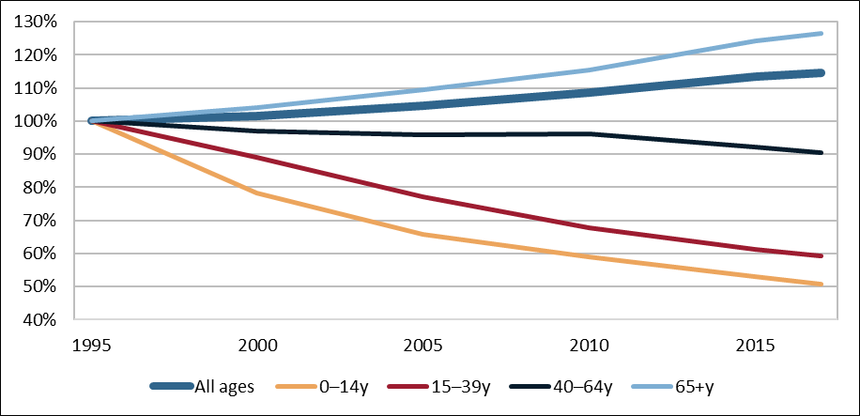
Cancer mortality by age group
Deaths from cancer are still increasing overall
In age groups below 65 years, deaths are (strongly) decreasing
Cancer mortality by age group (1995=base year) in Europe, 1995–2017
Notes: Figures are based on total number of deaths (not per 100,000 inhabitants)
Source: IARC and Eurostat
Notes:
One in four (26%) deaths in Europe is due to cancer, and cancer mortality over-all is increasing, due to an increasing incidence of cancer in the elderly. However. We also see a very strong decline in the mortality in the younger age groups, even if we should remember that cancer also is the leading cause of death in persons under 65 years (10-40% in the economically active population).

Slide 3
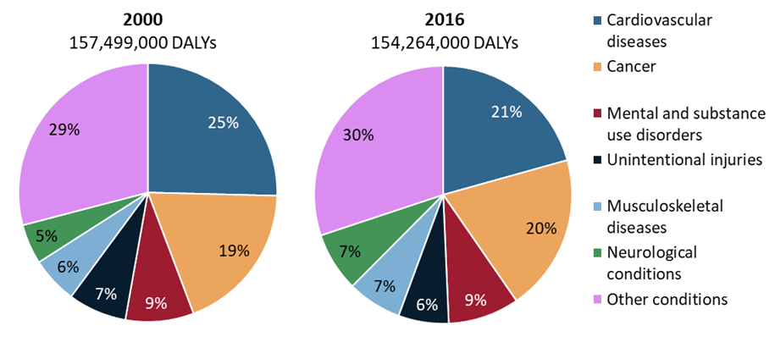
Disease burden of cancer - DALYs
Cancer is the 2nd leading cause of DALYs behind cardiovascular diseases
Cancer has already become the leading cause of DALYs in many wealthier countries (BE, DK, FR, IS, IE, IT, LU, NL, NO, PT, SI, ES, CH, UK)
DALYs (Disability Adjusted Life Years) comprise the effect of premature mortality and morbidity of a disease
Disease burden of the largest disease groups in Europe, 2000 & 2016
Source: WHO
Notes:
DALY is a measure of disease burden that combines the impact of the disease on mortality and morbidity. In the year 2000 a quarter of the total disease burden came from cardiovascular diseases. In 2018 this share was reduced to 21%, while cancer increased from 19 to 20%.
In many European countries, like Belgium, Netherlands and Luxembourg, cancer is already the largest burden.

Slide 4
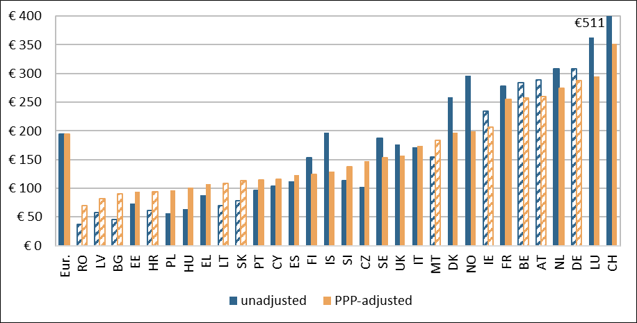
Direct costs of cancer in 2018
All countries spent between
4–7% of total health expenditure on cancer in 2018
5-fold difference between lowest spender (€70, Romania) and highest spender (€352, Switzerland) if PPP-adjusted (if not, 14-fold difference!)
Direct costs = resources within the health care system (medical equipment, staff, medicines, etc.)
Direct costs of cancer per capita (in €), 2018
Notes: Hatched bars indicate that the direct costs are estimated based on data from similar countries; see Appendix for methodology. The blue bar for CH is truncated - its true size is €511.
Notes:
Health care spending on cancer is small in relation to the disease burden, and has been rather stable at 5-6% for a very long time. Since the share is similar in all countries, it is the total health care per person that explain the variation in spending on cancer per capita.
That makes for very great differences between the European countries. I five fold differences if expenditures are measured in purchasing power parities, but over ten fold if measured by current exchange rates. And it is the latter that determines a country´s ability to pay for imported cancer medicines.

Slide 5
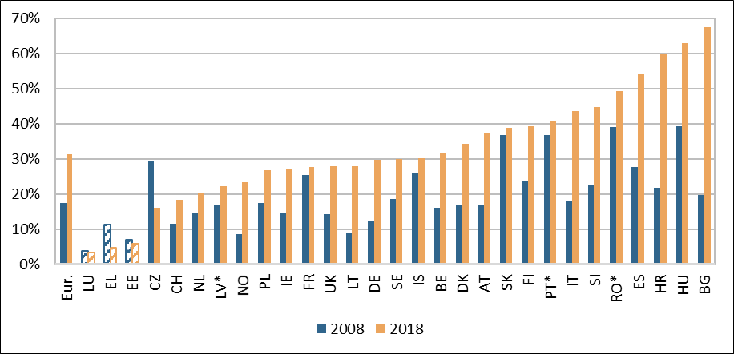
Cancer medicines account for a growing share of direct costs
Share of cancer medicines increased from 17% to 31% in Europe
Poorer countries spend a larger share of direct costs spent on cancer medicines
Wealthiest countries spend the lowest share of direct costs on cancer medicines
Share of the cost of cancer medicines on the direct costs of cancer, 2008 & 2018
Notes: Hatched bars indicate that data for cancer medicines for EE, EL, and LU only comprise retail sales. * The share in 2008 for PT is from 2010, for RO from 2009, and for LV from 2014.
Notes:
Cancer medicines account for a growing share of the health care expenditures on cancer. The share is also particularly high in some countries with lower income per capita, but the data are somewhat uncertain.
Interesting is that the higher share for cancer medicines over time has been accompanied with a similar reduction the cost of inpatient hospital care for cancer.

Slide 6
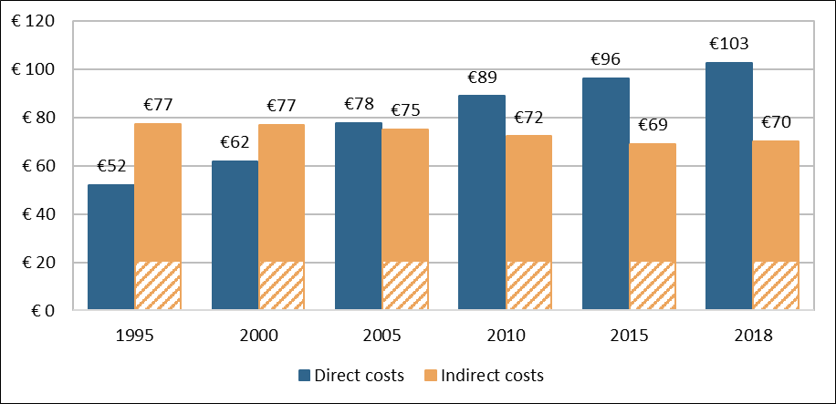
Total costs of cancer between 1995–2018
Total costs in Europe increased from €129 to €173 billion between 1995 and 2018
Increase in direct costs (typically by 60–150% in wealthier countries and >200% in poorer countries)
Decrease in indirect costs (typically by 15–30% in wealthier countries and 0–10% in poorer countries)
Total costs of cancer in Europe (in billion €; 2018 prices & exchange rates), 1995–2018
Notes: The hatched part of the indirect costs indicates uncertain estimates of the size of productivity loss from morbidity.
Notes:
Looking at the total of direct and indirect costs, the indirect costs due to premature mortality from cancer has declined over time. Indirect costs for cancer morbidity are smaller, and data for assessing change over time are lacking. However, a tentative conclusion is that they have been rather unchanged.

Slide 7
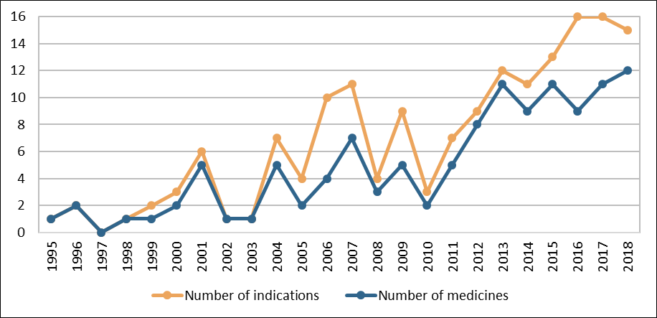
Growing stream of cancer medicines and indications
118 EMA approvals of new medicines in oncology (ATC groups L01, L02 and some in L04) and 164 indications
Steep increase in the number of approved cancer medicines and indications
Number of EMA-approved cancer medicines and indications, 1995–2018
Notes: Indications refer to label extensions to cancer types in addition to the initially approved cancer type
Source: EMA
Notes:
Since 1995, a total of 118 new cancer medicines have been approved. Up until 1995, only 40 cancer drugs in total had been introduced, as many as have been introduced during the last four years.

Slide 8
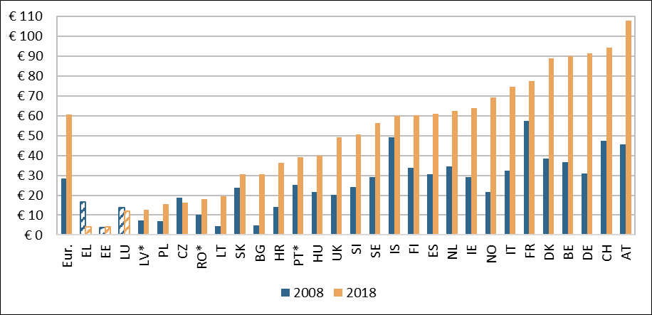
Access to cancer medicines (sales value)
Large country differences in spending on cancer medicines, and no signs of shrinking country differences over time
Poorer countries spend around one third of the amount of wealthier countries
Cost of cancer medicines per capita (in 2018 price levels and exchange rates), 2008 & 2018
Notes: Eur. = Europe. Hatched bars indicate that data for EE, EL, and LU only comprise retail sales. CY and MT are missing due to lack of data. * The values in 2008 are from 2014 for LV, from 2009 for RO, and from 2010 for PT.
Source: IQVIA
Notes:
Average sales per capita in Europe has doubled from 30 to 60 euro in 2018 prices. Sales per capita is 50% more than the average in countries like Denmark, Belgium, Germany, Switzerland and Austria, but half or less of the average in 13 countries.

Slide 9
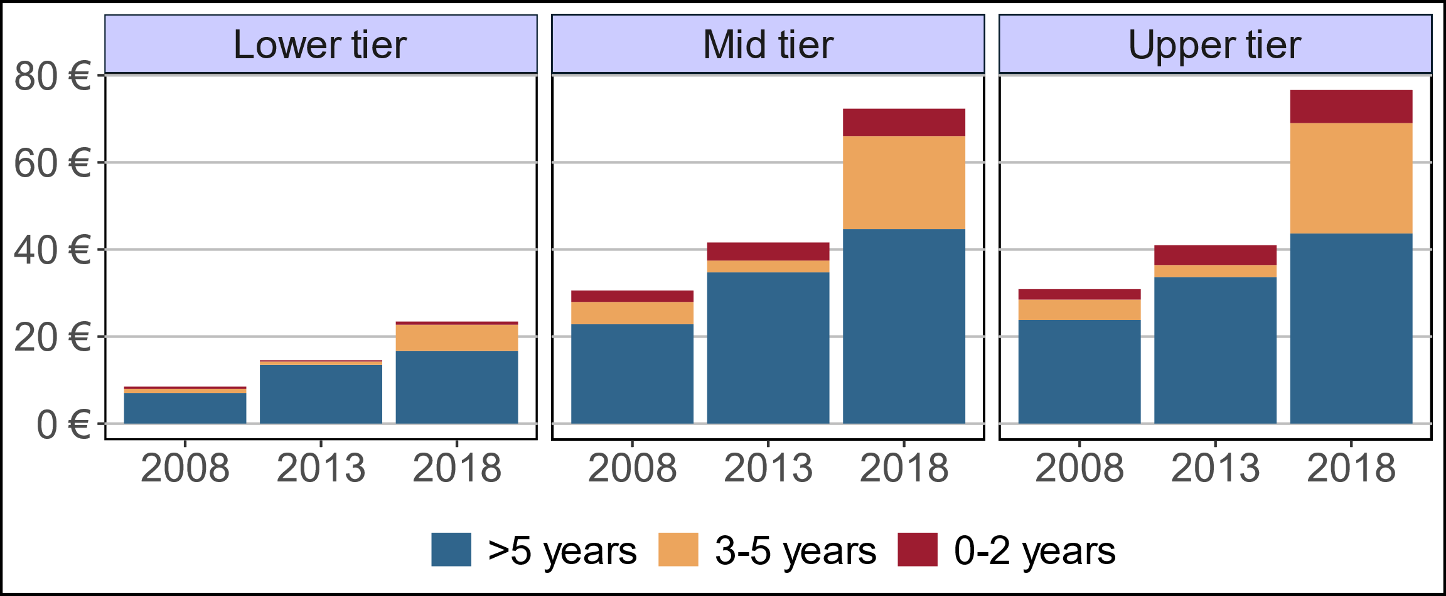
Access to newest cancer medicines
9%
10%
Small and stable share of sales of newest drugs (approved max. 2 years ago), …
… ranging from 3% in poorer countries to 10% in the wealthiest countries in 2018
Increasing share of sales of semi-new drugs (approved 3-5 years ago) due to immuno-therapies approved in 2015
9%
8%
3%
6%
Sales of cancer medicines (in € per capita) by time since EMA approval and group of country
Notes: Lower tier = BG, HR, CZ, HU, LV, LT, PL, PT, RO, SK, SI; Mid tier = FR, DE, IT, ES, UK; Upper tier = AT, BE, DK, FI, IS, IE, NL, NO, SE, CH
Source: IQVIA
Notes:
The lower sales is in countries with the lowest income level per capita. These are also the countries that spend the lowest amount on the cancer medicines introduced during the last 5 years.
While prices of cancer medicines may be somewhat lower in countries with low income per capita, we know that the difference is not significant. However, we will now look at some data where access is measured as volume.

Slide 10
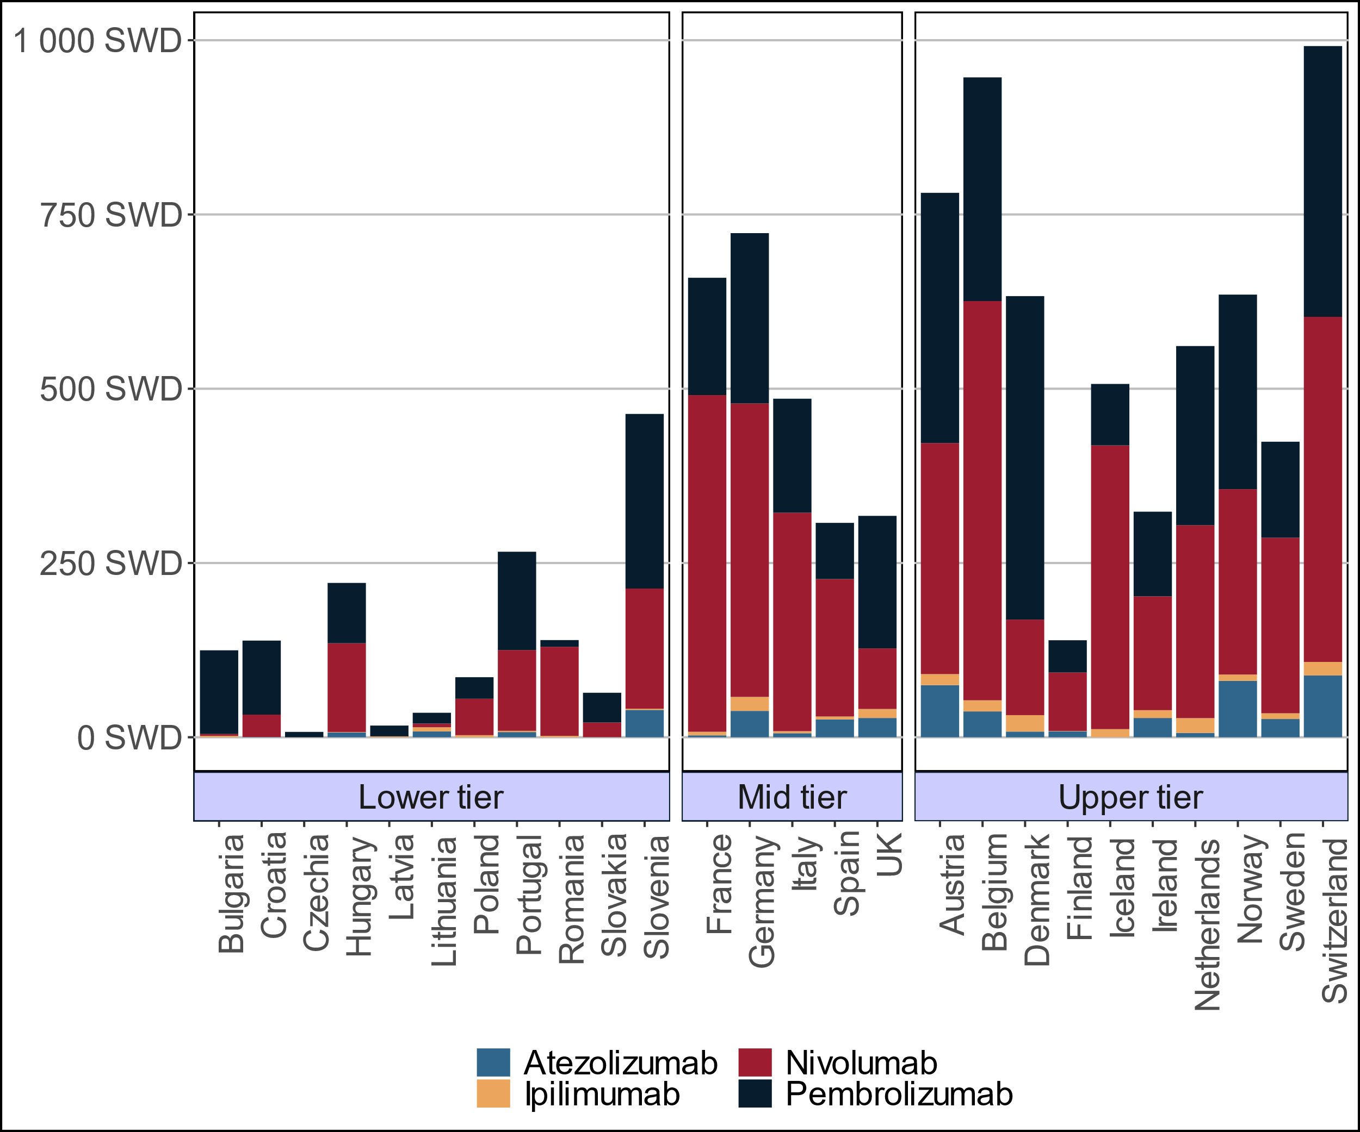
Access - immunotherapy medicines (volume)
Large differences in uptake even within country groups
Very low uptake in almost all poorer countries
Uptake of immunotherapy medicines expressed as sales in SWD per 100,000 inhabitants, 2018
Notes: SWD = standard weekly dose
Source: IQVIA
Notes:
Immuno-oncology started with the introduction of ipilimumab in 2011 but took off with the introduction of the less toxic and more effective PD-1 medicines, nivolumab and pembrolizumab, in
2015. Later PD-L1 medicines (atezolizumab and avelumab in 2017 and durvalumab in 2018) have been added to the immuno-oncology arsenal.
In general, access to immuno-oncology medicines is much higher in upper-tier and mid-tier countries compared lowertier countries which only have 10–20% of the former’s access levels.
There is however relatively large variation within the group of mid-tier countries with lower access in Spain and the UK, and also between the upper-tier countries with very low access in Finland.

Slide 11
Impact of Covid 19
Diversion of resources from cancer care in the short run
  Increased disease burden in the longer run due to later detection
  Effects of changes in management mitigated by attempts to maintain outcomes
Reduced incomes and tax revenue for public spending on health care in the coming years
  Increase competition for resources to cancer care
  Increase efforts to improve efficiency in cancer care
  Increase the importance of directing spending to the most cost-effective innovations

Slide 12

Cancer care spending and patient outcomes
Constrained resources and increasing demand for health care
Costs from investing in different areas of cancer care need to be weighed against potential improvements in patient outcomes
Use of scarce resources in a cost-effective and efficient way to ensure value-for-money for patients and taxpayers
Health care spending (€)
Patient outcomes (Health)
Notes:
We spend resources on treatment of cancer with the objective to improve outcomes in terms of improving survival and quality of life. Thus, access to new cancer medicines are most important for the most valuable medicines.
The importance of access is thus very closely linked to efficiency in cancer care. Unless the new cancer medicines are used for patients so that they improve outcome, access is not important.

Slide 13
How to improve access to cancer medicines in Europe
Prices must be aligned with ability to pay in countries with low income per capita
Payment per patient treated should be the new model
  Differentiated by indication
  Helps the problem how pay for combination therapies
Measures needed for improved accountability in health care spending
Notes:
Do we care about equal access to valuable cancer medicines in Europe? In that case, a new payment system is needed that take into account variations between countries in incomes and price levels.

Slide 14
The full Comparator report is available at: https://ihe.se/en/publicering/comparator-report-on-cancer-in-europe-2019/
Please cite this report as:
Hofmarcher, T., Brådvik, G., Svedman, C., Lindgren, P., Jönsson, B., Wilking, N. (2019) Comparator Report on Cancer in Europe 2019 – Disease Burden, Costs and Access to Medicines. IHE Report 2019:7. IHE: Lund, Sweden.
Related publication:
Hofmarcher, T., Lindgren, P., Wilking, N., Jönsson, B. (2020) The cost of cancer in Europe 2018. European Journal of Cancer. (forthcoming).

